Slide 1
Consistent Concurrent Design of
Cyber-Physical Systems
Ken Vanherpen

Slide 2



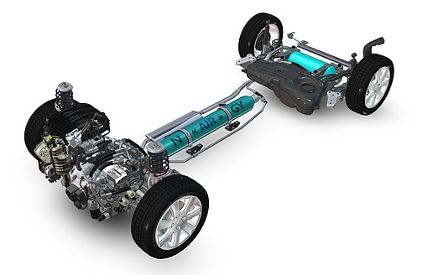

Why (is it a problem)?
“Abstraction
Level”
Multi-Viewpoint
Inconsistency
High
Inconsistency
Sample Time,
Settling Time,
Overshoot, …
Multi-Viewpoint
Inconsistency
Period,
Deadline,
Response Time, …
Low

Slide 3


Why (is it a problem)?
Control Design
In Theory
Preliminary Design
Integration
Embedded Design
t0
t1
t2
t3
time
Control Design
Control Design
In Practice
…
Preliminary Design
Integration
…
Integration
Embedded Design
Embedded Design
…
t0
t1
t2
t3
t4
…
tn
time
Notes:
Fork zetten om co-design pad duidelijk te maken??

Slide 4
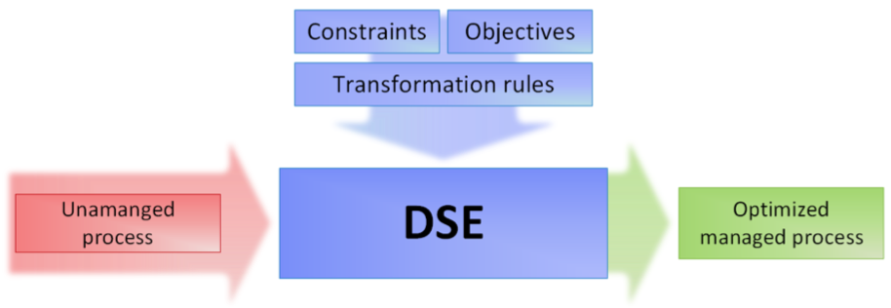
What (is the solution)?
Inconsistency detection and resolution
Inconsistency avoidance

Slide 5
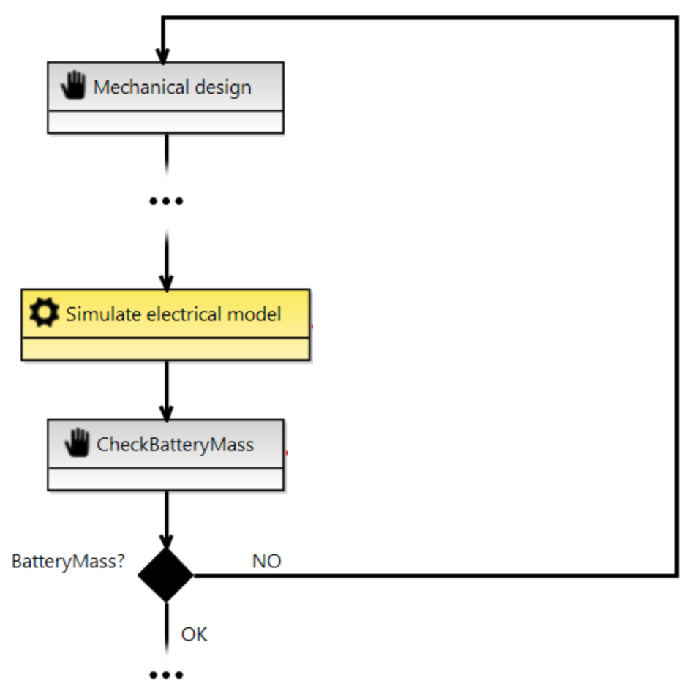
How (do we implement the solution)?
Inconsistency detection and resolution
Inconsistency avoidance
+
Assumptions
Guarantees
+

Slide 6
How (do we implement the solution)?
Inconsistency avoidance: Contract-Based Co-Design
Notes:
Uitleggen architecturen
Wanneer pas ik dit toe?
V-Model nodig?

Slide 7
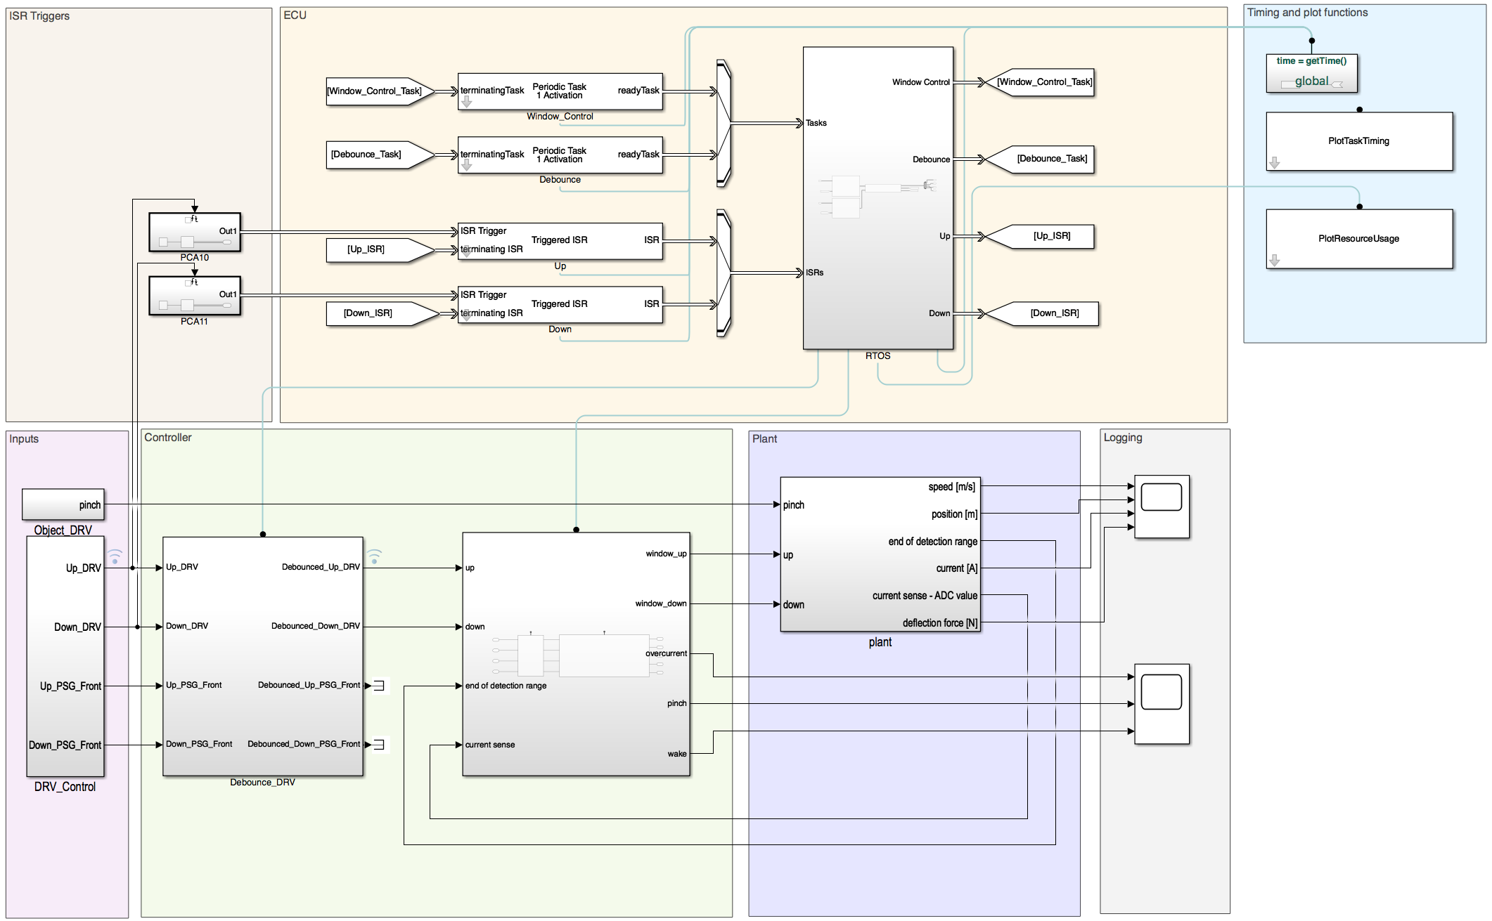

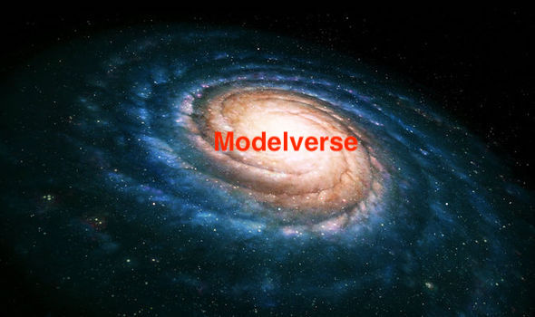


Roadmap
CSE_CoDesign_ICON
POC/IM
time

Slide 8
Related Work
Albert Benveniste, Benoît Caillaud, Dejan Nickovic, Roberto Passerone, Jean-Baptiste Raclet, Philipp Reinkemeier, Alberto L. Sangiovanni-Vincentelli, Werner Damm, Tom Henzinger, and Kim G. Larsen. Contracts for Systems Design : Theory. Technical Report RR-8759, INRIA, 2015.
Albert Benveniste, Benoît Caillaud, Dejan Nickovic, Roberto Passerone, Jean-Baptiste Raclet, Philipp Reinkemeier, Alberto L. Sangiovanni-Vincentelli, Werner Damm, Tom Henzinger, and Kim G. Larsen. Contracts for Systems Design: Methodology and Application cases. Technical Report RR-8760, INRIA, 2015.
Patricia Derler, Edward A. Lee, Stavros Tripakis, and Martin Törngren. Cyber-Physical System Design Contracts. In Proceedings of the ACM/IEEE 4th International Conference on Cyber-Physical Systems, ICCPS ’13, pages 109–118, New York, NY, USA, 2013. ACM.
Pierluigi Nuzzo, Alberto L. Sangiovanni-Vincentelli, Davide Bresolin, Luca Geretti, and Tiziano Villa. A Platform-Based Design Methodology With Contracts and Related Tools for the Design of Cyber-Physical Systems. Proceedings of the IEEE, 103(11):2104–2132, 2015.
Martin Törngren, Ahsan Qamar, Matthias Biehl, Frederic Loiret, and Jad Elkhoury. Integrating viewpoints in the development of mechatronic products. Mechatronics, 24(7):745–762, 2014.
István Dávid, Joachim Denil, Klaas Gadeye, and Hans Vangheluwe. Engineering Process Transformation to Manage (In)consistency. In Proceedings of the 1st International Workshop on Collaborative Modelling in MDE (COMMitMDE), volume 1717 of CEUR Workshop Proceedings, pages 7–16, 2016.
Ken Vanherpen. A Contract-Based Approach for Multi-Viewpoint Consistency in the Concurrent Design of Cyber-Physical Systems. PhD Thesis, University of Antwerp, 2018.

